Slide 1
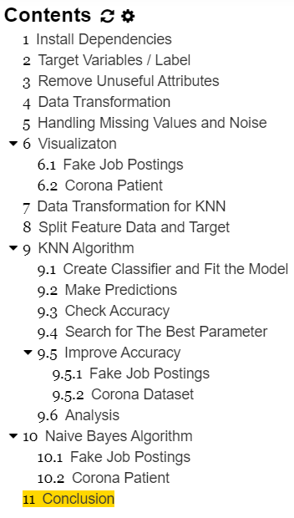
OUTLINE OF WHAT I DO

Slide 2
TARGET VARIABLE
Label of Fake Job Postings Dataset: fraudulent (1=True | 0=False)
Label of Corona Patient Dataset: state (Isolated | Released | Deceased)

Slide 3
REMOVE UNUSEFUL ATTRIBUTES

Slide 4
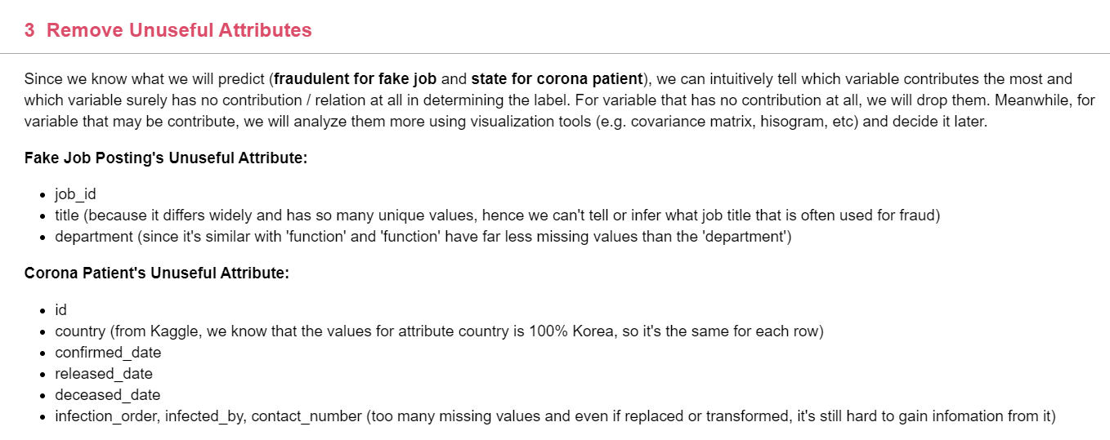

Slide 5
DATA TRANSFORMATION

Slide 6
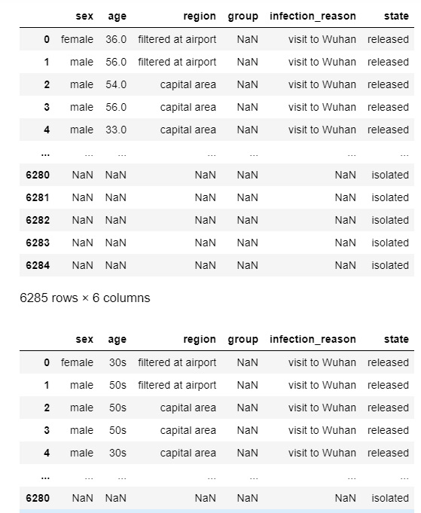

Slide 7
HANDLING MISSING VALUES

Slide 8
For some attributes that need deeper algorithm to process them (e.g text mining algorithm to process 'description' in Fake Jobs Posting Dataset), we will convert the value into 1 (value is provided) and 0 (value isn't provided).
While for the other remaining attributes (categorical) that still contain Null, we will treat any missing values as 'missing value' or 'unavailable'. Thus, we won't drop them, but replace them with more meaningful name (new unique value).

Slide 9
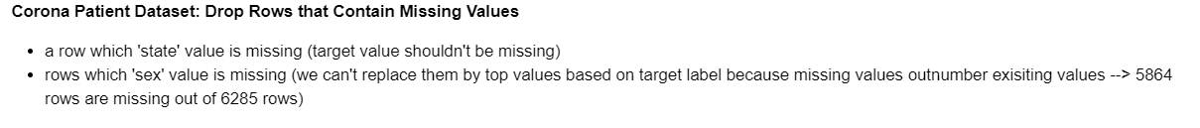

Slide 10
KNN ALGORITHM
Initial Parameters

Slide 11
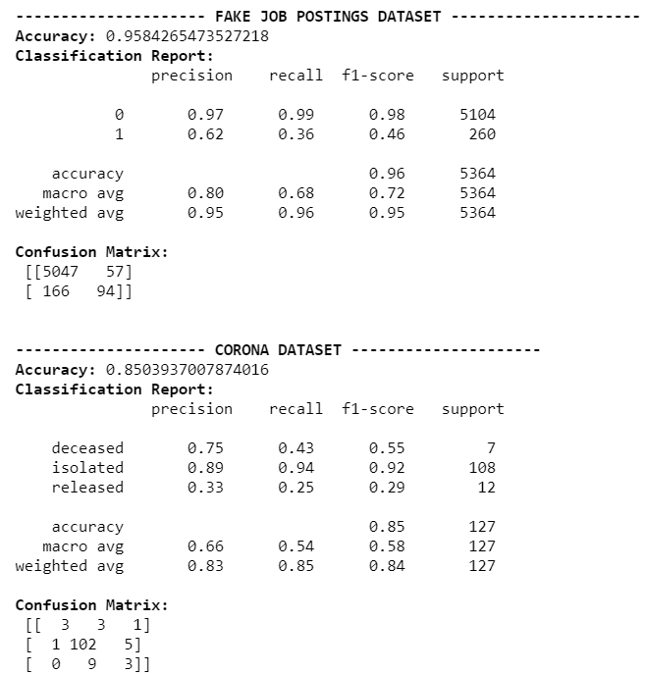

Slide 12
KNN ALGORITHM
Best Parameters

Slide 13
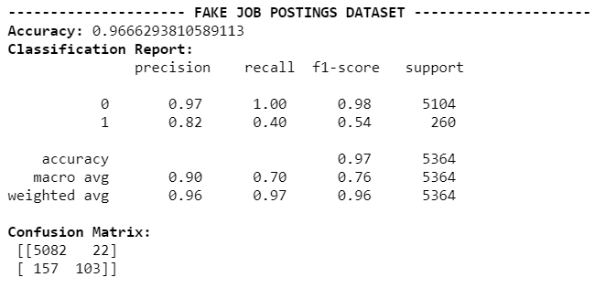
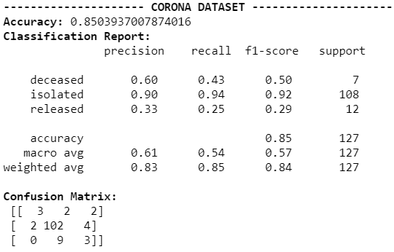

Slide 14
NAIVE BAYES ALGORITHM

Slide 15
